Slide 1

EditEdit MasterMaster texttext stylesstyles
Practical Lecture 5: Class and Object

Slide 2

Quick Recap
Let’s take a quick recap of previous lecture –
A) Structure
B) Union
C) Enum
D) Functions

Slide 3
Today’s Agenda
Today we are going to cover -
Class
Object
Explaining class and object with example
Creating class function inside the class.
Creating Class function Outside the class
Practice Questions

Slide 4
C++
Let’s Get Started-

Slide 5
Review: Two Programming Paradigms
Structural (Procedural) Object-Oriented
PROGRAM PROGRAM
FUNCTION
OBJECT
Operations
Data
FUNCTION
OBJECT
OBJECT
Operations
Data
FUNCTION
Operations
Data
Function calls
Messages passing
Notes:
A list of tasks to perform.
Viewed as a collection of interacting objects. Each object can be viewed as an independent machine with a distinct role or responsibility. Operations are closely associated with the objects, carry their own operators around with them .

Slide 6

What is an Object?
The real world is composed of different kinds of objects: buildings, men, women, dogs, cars, etc.
Each object has its own states and behaviors.
Behaviors
Color = Blue
Brand = Ferrari
Speed = 200 mph
Gear = 4
States
Changing
Gear
Steering
Accelerating
Braking
Variables and functions

Slide 7
Object-Oriented Programming-- Introduction to Classes
Class Definition
Class Examples
Objects

Slide 8
Class Interface Diagram
student class
Private data:
name
id
marks
display
Set
Notes:
Operations vs. Data

Slide 9
Class and Object
A class in C++ is the building block, that leads to Object-Oriented programming.
It is a user-defined data type, which holds its own data members and member functions, which can be accessed and used by creating an instance of that class.
A C++ class is like a blueprint for an object.
An Object is an instance of a Class.
When a class is defined, no memory is allocated but when it is instantiated (i.e. an object is created) memory is allocated

Slide 10
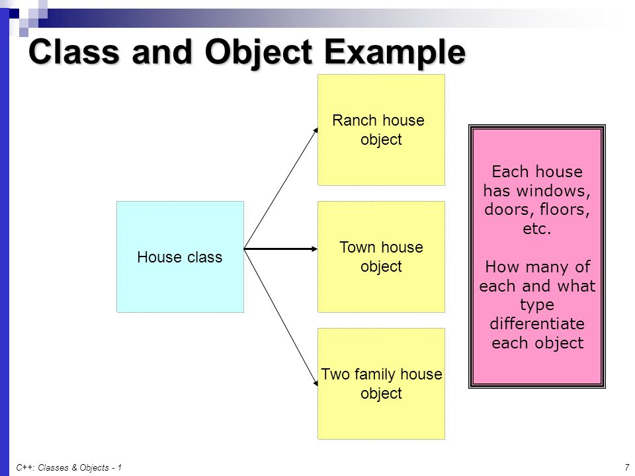
Class and Object Example

Slide 11
Class and Object example
#include <iostream>
#include<string>
using namespace std;
class Student{ // we are creating class with class keyword
public: //Access modifiers
string studentName; //Data members of the class
int rollNumber;
int tutionFess;
};

Slide 12
Class and Object example
int main() {
Student studentOne; // creating object of student class
studentOne.studentName="Vikash";
studentOne.rollNumber=55;
studentOne.tutionFess=400000.00;
cout<<"The student name is"<<" "<<studentOne.studentName<<endl; // endl is used for the next line
cout<<"The student roll number is"<<" "<<studentOne.rollNumber<<endl;
cout<<"The student tution fees is"<<" "<<studentOne.tutionFess<<endl;
}

Slide 13
Class and Object example
Output
The student name is Vikash
The student roll number is 55
The student tution fees is 400000

Slide 14
Creating multiple object for the class
#include <iostream>
#include<string>
using namespace std;
class Student{ // we are creating class with class keyword
public: //Access modifiers
string studentName; //Data members of the class
int rollNumber;
int tutionFees;
};

Slide 15
Creating multiple object for the class
int main() {
Student studentOne; // creating object of student class
studentOne.studentName="Vikash";
studentOne.rollNumber=55;
studentOne.tutionFees=400000.00;
cout<<"The student name is"<<" "<<studentOne.studentName<<endl; // endl is used for the next line
cout<<"The student roll number is"<<" "<<studentOne.rollNumber<<endl;
cout<<"The student tution fees is"<<" "<<studentOne.tutionFees<<endl;

Slide 16
Creating multiple object for the class
Student studentTwo; // creating object of student class
studentTwo.studentName="Mukesh";
studentTwo.rollNumber=44;
studentTwo.tutionFees=500000.00;
cout<<"The student name is"<<" "<<studentTwo.studentName<<endl; // endl is used for the next line
cout<<"The student roll number is"<<" "<<studentTwo.rollNumber<<endl;
cout<<"The student tution fees is"<<" "<<studentTwo.tutionFees<<endl;
}

Slide 17
Output
The student name is Vikash
The student roll number is 55
The student tution fees is 400000
The student name is Mukesh
The student roll number is 44
The student tution fees is 500000

Slide 18
Creating Function Inside the class
class Student{ // we are creating class with class keyword
public: //Access modifiers
string studentName; //Data members of the class
int rollNumber;
int tutionFees;
void studentInfoDisplay(){
cout<<"The student name is"<<" "<<studentName<<endl; // endl is used for the next line
cout<<"The student roll number is"<<" "<<rollNumber<<endl;
cout<<"The student tution fees is"<<" "<<tutionFees<<endl;
}
};

Slide 19
Creating Function inside the class
int main() {
Student studentOne; // creating object of student class
studentOne.studentName="Vikash";
studentOne.rollNumber=55;
studentOne.tutionFees=400000.00;
studentOne.studentInfoDisplay();
}

Slide 20
Creating function outside the class
#include <iostream>
#include<string>
using namespace std;
class Student{ // we are creating class with class keyword
public: //Access modifiers
string studentName; //Data members of the class
int rollNumber;
int tutionFees;
void studentInfoDisplay();
};

Slide 21
Creating function outside the class
void Student :: studentInfoDisplay(){ // methods defined outside the class
cout<<"The student name is"<<" "<<studentName<<endl; // endl is used for the next line
cout<<"The student roll number is"<<" "<<rollNumber<<endl;
cout<<"The student tution fees is"<<" "<<tutionFees<<endl;
}

Slide 22
Creating function outside the class
int main() {
Student studentOne; // creating object of student class
studentOne.studentName="Vikash";
studentOne.rollNumber=55;
studentOne.tutionFees=400000.00;
studentOne.studentInfoDisplay();
}

Slide 27

QNA Time
Any Questions??
Any Questions ??

Slide 28
Thank You!
See you guys in next class.

